Slide 1
JOM KENALI MICROSOFT
Farizmohd.weebly.com

Slide 2
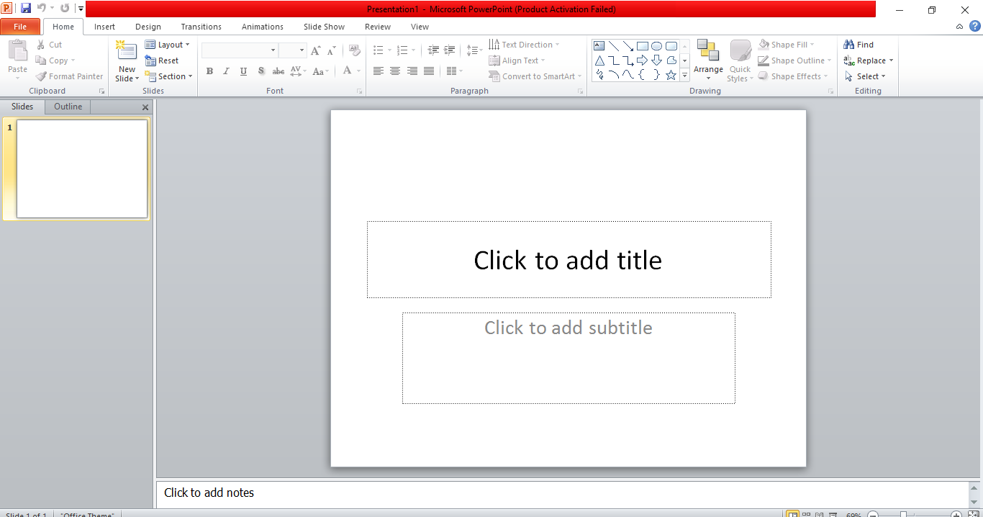
Farizmohd.weebly.com

Slide 3
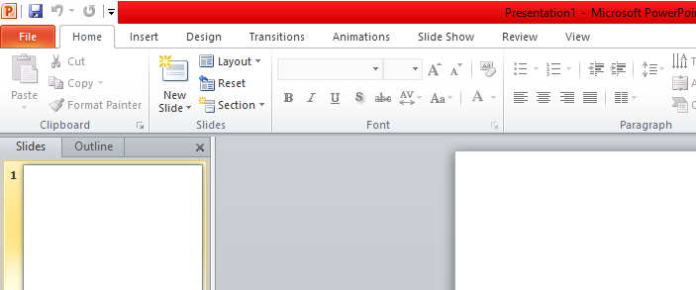
Menu Bar
Farizmohd.weebly.com

Slide 4
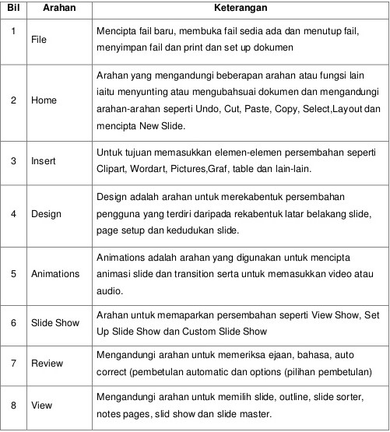
Farizmohd.weebly.com

Slide 5
Standard Bar
Farizmohd.weebly.com

Slide 6
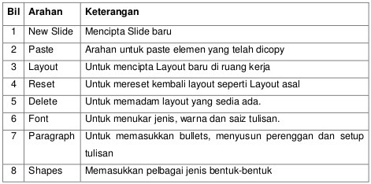
Farizmohd.weebly.com

